Slide 1
WELCOME TO MY Presentation

Slide 2
SCANNING IN TELEVISION SYSTEM

Slide 3
CONTENT
Introduction.
Television Scanning.
Beam Scanning.
Horizontal Scanning.
Vertical Scanning.

Slide 4


Slide 6
Introduction
A still picture is fundamentally an arrangement of many dark and light areas.
Each small area of light or shade is called a picture element.
All the elements contain the visual information in the scene.
If they are transmitted and reproduced in the same degree of light or shade as original and in proper position, the picture will be reproduced.

Slide 7
Television Scanning
What is scanning in TV system?
It is the process by which an electron beam spot is made to move across a rectangular area , so as to cover it completely.
This rectangular area may be the target surface in a television camera or the screen of a picture tube in a television receiver.
The EB excites a single unit of each line ,called a picture element or pixel, which emits light.

Slide 8
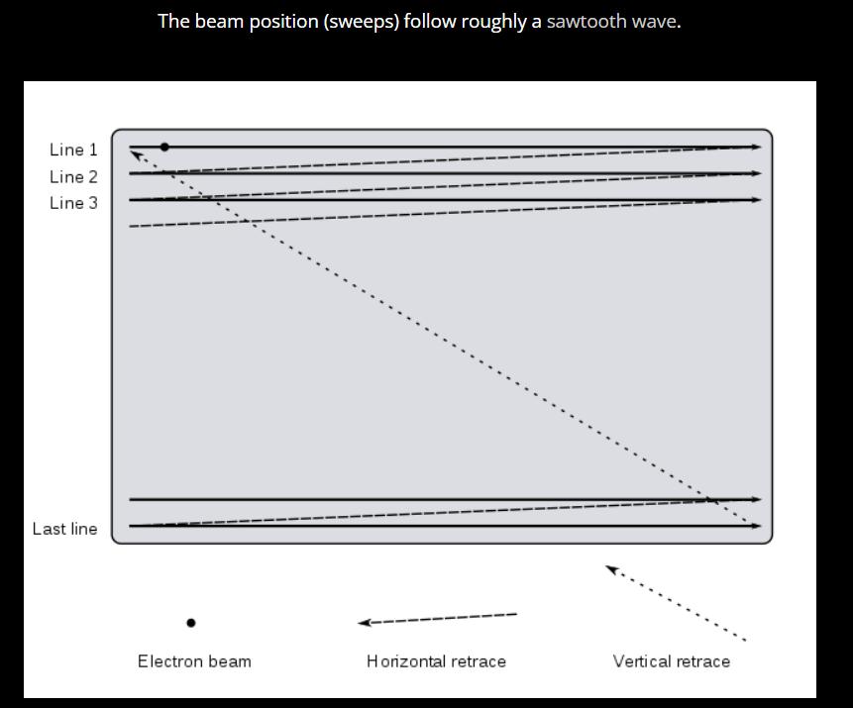

Slide 9
Beam Scanning
In order to produce video signal for all the elements in the picture, it is scanned by the electron beam, one element at a time, in sequential order. The scanning is done in the same way as a written page is read to cover all the words in one line and all lines on the page.
One complete frame of a TV picture EB is scans the screen from left to right and top to bottom.
Covering the entire screen 30 times per second.

Slide 10
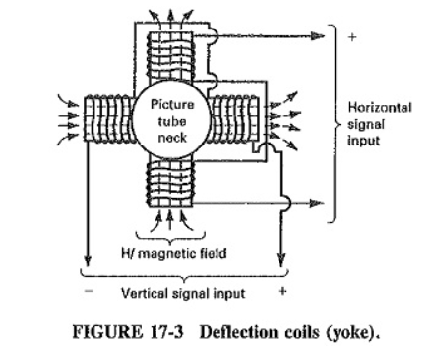
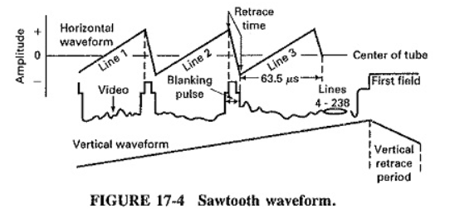
Deflection coils & Sawtooth Waveform

Slide 11
Beam Scanning Cont.
the electron beam is directed to move by deflection coils (yoke), which are located around the neck of the picture tube (Figure 17-3).
The information applied to the deflection coils is in the form of a Sawtooth Waveform in Beam Scanning (Figure 17-4), generated by the horizontal oscillator, which occurs at a rate or frequency determined by the number of lines (525) to be scanned and the scanning rate (30 frames per second).

Slide 12
Horizontal Scanning
The linear rise of current in the horizontal deflection coils deflect the beam across the screen with a continuous ,uniform motion for the trace from left to right.
At the peak of the rise , the SAWTOOTH wave reverses direction and decreases rapidly to its initial value.
This fast reversal produces the retrace or flyback.

Slide 13
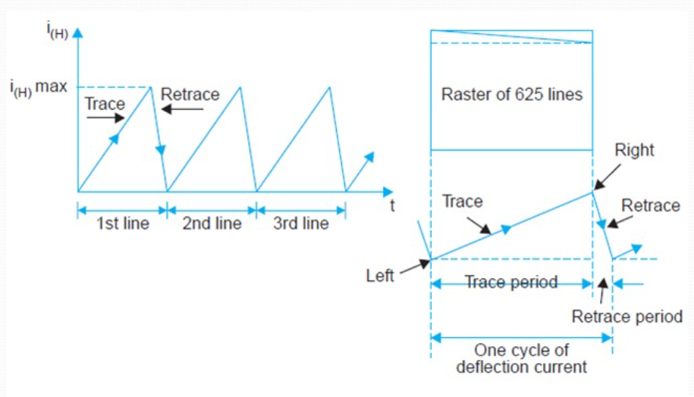
Horizontal Scanning

Slide 14
Vertical Scanning
The SAWTOOTH current in the vertical deflection coils moves the electron beam from top to bottom of the raster at a uniform speed while the electron beam is being deflected horizontally.
Both during the horizontal retrace and vertical retrace intervals the scanning beams at the camera tube and picture tube are blanked , no picture information is either picked up or reproduced.

Slide 15
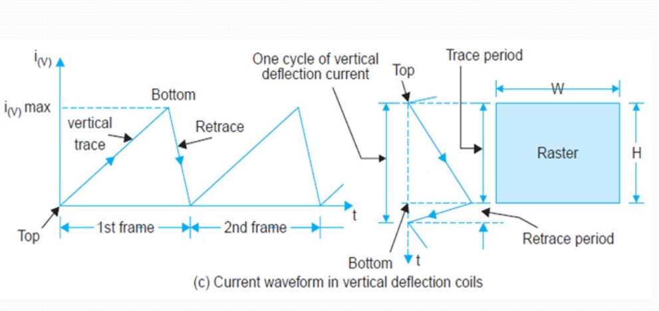
Vertical Scanning

Slide 16
THANK YOU

